Slide 2
Value – Cost =Return which pays:
Cost of debt: interest on a construction loan (variable rate 4% to 6.5%)
Return on equity: return to investors (15% to 20%)
Developer profit: based on project performance after paying costs of capital.

Slide 3
A viable project has a value sufficient to:
attract debt and equity to fund all project costs (including cost of capital) and
compensate the developer for skill and time

Slide 4
Economics of Income Property
Development and Ownership
FINANCING
DEVELOPMENT COSTS
Developers Fee
A&E
Land/Infrastructure
Equity
Gap
Legal
.
Construct Interest.
Construction Cost
Private debt based on
Debt Service Coverage Ratio
OR Loan-to-Value
OR Loan-to-Cost Ratio
Private Debt
OPERATIONS
NET
OPERATING
INCOME
(NOI)
GROSS
INCOME
-
OPERATING
EXPENSES
=
-
OPERATING
CASH FLOW
(OPCF)
DEBT SERVICE
= Rent
+ Other Income
- Vacancy
= (Maintenance, Management, Taxes, Insurance)
+ Utilities
+ Replacement Reserves
= Periodic
Return to
Investors
4

Slide 5
Value of an “income” project.
e. g. apartments, offices, retail stores, industrial buildings, hotels, business parks…; i.e. real estate with a Net Operating Income.
NOI
Project Value =
Capitalization Rate
OR:
NOI
Capitalization Rate=
Project Value
If you can increase NOI, you can increase project market value
5

Slide 6
The cap rate indicates how the market values a stream of income (NOI)
Or, the same NOI with a different
property condition
sector
Regional and local market
capital market conditions
has a different value, and that difference is reflected by the “all in” market indicator called a “cap rate”.
6

Slide 7
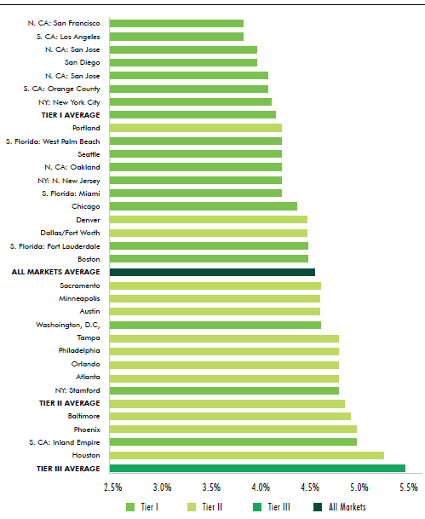
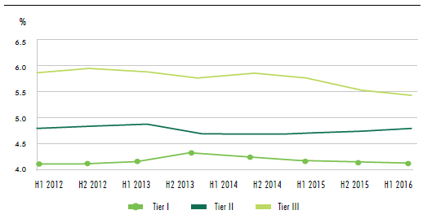
Cap rates differ by sector, city and over time
4.1%
Multi-family
4.4%
4.7%
5.5%
Source: CBRE H1 2016 Cap Rate Survey

Slide 8
Web sites where you can track cap rates by region, sector and investor type
CBRE https://www.cbre.com/research-and-reports
Real Estate Research Council www.rerc.com
Real Capital Analytics http://global.rcanalytics.com/
National Council of Real Estate Investment Fiduciaries (NCREIF) http://www.ncreif.com
Reis: http://www.reis.com/index.cfm
Notes:
The cap rate is such an important market metric, that many investor research services gather data on transactions and produce reports on current cap rates by sector and by region. Here are just a few of the many web based services that you can use to get this information.

Slide 9
Cap rate is the inverse of the P/E ratio used in the stock market
Cap rate P/E Ratio
2% 50
3% 33
4% 25
5% 20
6% 16.7
And, is the same type of market indicator—i.e. an indicator of investor preferences.
9

Slide 10
Other stock P/E ratios
General Electric 15.87
Microsoft 22.42
Starbucks 26.70
Amazon 273.99
What does a high P/E (or low cap rate) signal about investor expectations on income?
Source: NASDAQ web site
10

Slide 11
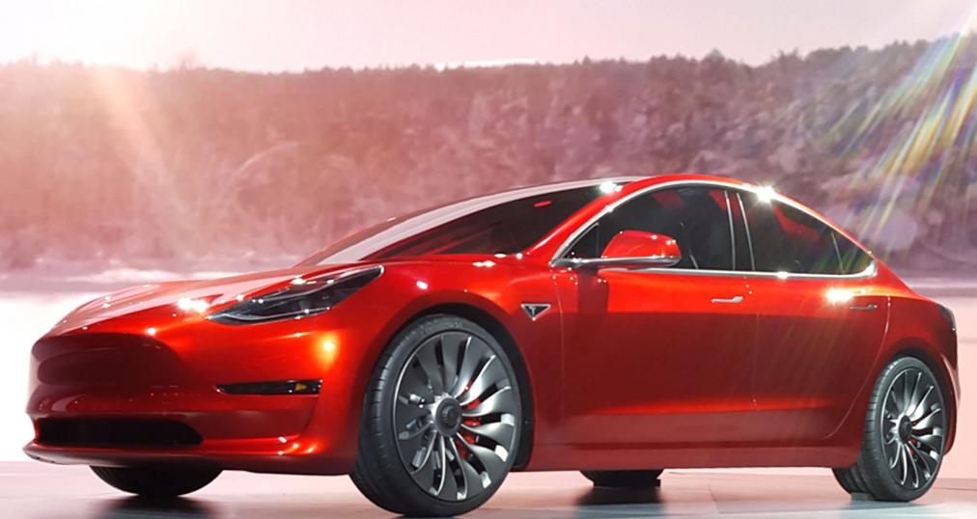
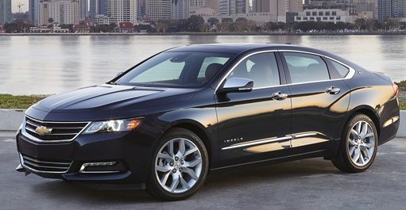
Tesla
General Motors
$61 billion market value
$7 billion annual sales
P/E Ratio: current (47.05)
Projected 2019 79.59
Cap rate of 1.26%
$57.4 billion market value
$166 billion annual sales
P/E Ratio: 6.39
Cap rate of 15.65%

Slide 12
Feasible Project Costs are the maximum costs that can be incurred and still attract investment.
Feasible Project Costs
Actual Costs
minus
>=
0
Actual costs less than Feasible Project Costs---No Gap

Slide 13
The GAP
No Gap
Value>=Feasible Project Costs
Soft Costs
Value at completion
Soft Costs
Land
Land
Construction and Fees
Construction and Fees

Slide 14
A project’s “return on cost” requirement is a quick indicator of its cost of capital First, what is the required blended cost of capital?
Example
Cost of equity: 20% per year (30% of costs) = 6%
Cost of debt: 5% per year (70% of costs) = 3.5%
TOTAL ANNUAL COST OF CAPITAL = 9.5%
If a project takes 2 years to construct, the cost of capital is: 9.5% per year or a total of about 20%.

Slide 15
The minimum required cash-on-cash return is the “hurdle rate” based on blended cost of capital and duration of development period
Feasible Project Costs
Project Value
=
1 + hurdle rate
15

Slide 16
Hurdle rate varies with project development period.
1-year: about 10% (single family homes)
2-years: about 20% (below 4 stories)
3-years: about 30% (mixed use above 4 stories)

Slide 17
Pop quiz 2 What is the Feasible Project Cost?
Project Value Hurdle Rate
$36,000,000 20%
$39,000,000 30%
$50,000,000 25%
$60,000,000 25%
17

Slide 18
Hinescompetition@uli.org
18

